Slide 1

A Programming Language for Thinking about Algorithms
ACCU London Online – May 2021
local – global – everywhere – nowhere

Slide 2


APL

Slide 3
What are Algorithms?
A set of instructions to accomplish some task
Something like a recipe

Slide 4
What is Algorithms?
big_nuggets = 0
for nugget in bag_of_nuggets
if nugget.weight > 50
big_nuggets += 1
endif
endfor

Slide 5
Abstraction
Pro
Get rid of "unnecessary" details
Con
Black boxes are opaque

Slide 6
Spot patterns. Subordinate detail.
big_nuggets = 0
for nugget in bag_of_nuggets
if nugget.weight > 50
big_nuggets += 1
endif
endfor
Initialisation
Iteration
Comparison
Accumulation

Slide 7
Spot patterns. Subordinate detail.
big_nuggets = 0
for nugget in bag_of_nuggets
if nugget.weight > 50
big_nuggets += 1
endif
endfor
big_nuggets ← +/ bag_of_nuggets.weight > 50

Slide 8




Pretense: Striking a Balance
Computer's thoughts /
Execution speed
01001001
My thoughts /
Development speed

Slide 9
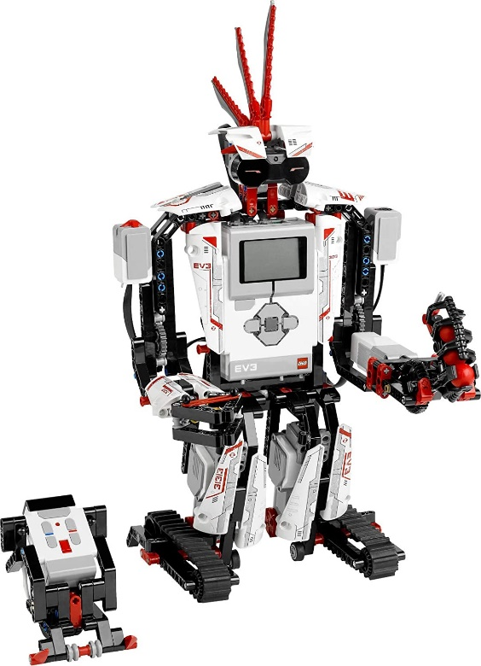
LEGO-brick Programming

Slide 10

LEGO-brick Programming

Slide 11
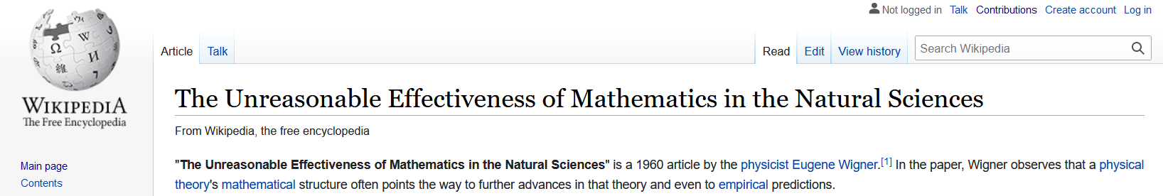
The Unreasonable Effectiveness
Strip away everything that is not the problem

Slide 12
Example: Take 4 Words
sentence ← 'this is a sentence with words'
this is a sentence

Slide 13
Example: Take 4 Words
sentence ← 'this is a sentence with words'
⍝ Split into words
' '(≠⊆⊢)sentence
┌────┬──┬─┬────────┬────┬─────┐
│this│is│a│sentence│with│words│
└────┴──┴─┴────────┴────┴─────┘
⍝ Take 4 words
4↑' '(≠⊆⊢)sentence
┌────┬──┬─┬────────┐
│this│is│a│sentence│
└────┴──┴─┴────────┘
⍝ Rejoin into sentence

Slide 14
Example: Take 4 Words
'this' 'is' 'a' 'sentence'
┌────┬──┬─┬────────┐
│this│is│a│sentence│
└────┴──┴─┴────────┘
' '∘,¨'this' 'is' 'a' 'sentence'
┌─────┬───┬──┬─────────┐
│ this│ is│ a│ sentence│
└─────┴───┴──┴─────────┘
∊' '∘,¨'this' 'is' 'a' 'sentence'
this is a sentence
1↓∊' '∘,¨'this' 'is' 'a' 'sentence'
this is a sentence

Slide 15
Example: Take 4 Words
+/1 2 5 6
14
1+2+5+6
14
×/1 2 5 6
60
⌈/1 2 5 6
6
⌊/1 2 5 6
1

Slide 16
Example: Take 4 Words
'this' 'is' 'a' 'sentence'
┌────┬──┬─┬────────┐
│this│is│a│sentence│
└────┴──┴─┴────────┘
'this' (⊣,' ',⊢) 'that'
this that
⊃(⊣,' ',⊢)/'this' 'is' 'a' 'sentence'
this is a sentence

Slide 17
Example: Take 4 Words
sentence ← 'this is a sentence with words'
' '=sentence
0 0 0 0 1 0 0 1 0 1 0 0 0 0 0 0 0 0 1 0 0 0 0 1 0 0 0 0 0
+\' '=sentence
0 0 0 0 1 1 1 2 2 3 3 3 3 3 3 3 3 3 4 4 4 4 4 5 5 5 5 5 5
4>+\' '=sentence
1 1 1 1 1 1 1 1 1 1 1 1 1 1 1 1 1 1 0 0 0 0 0 0 0 0 0 0 0
sentence⌿⍨4>+\' '=sentence
this is a sentence

Slide 18
Computational Complexity

Slide 19
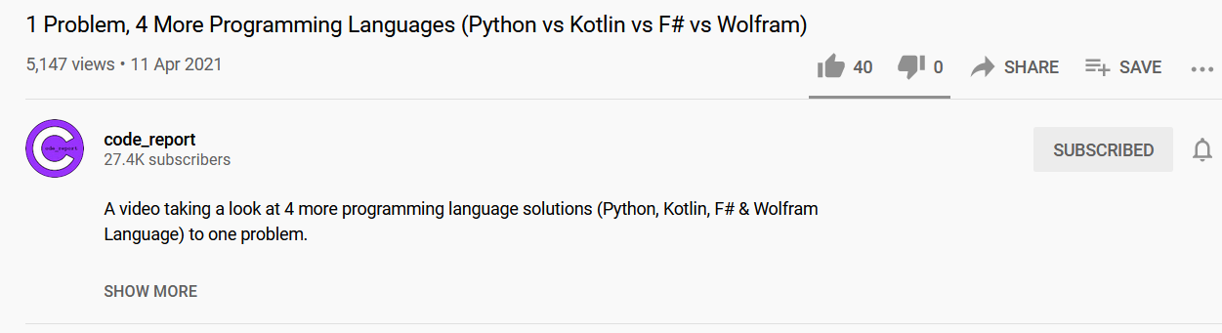

Slide 20
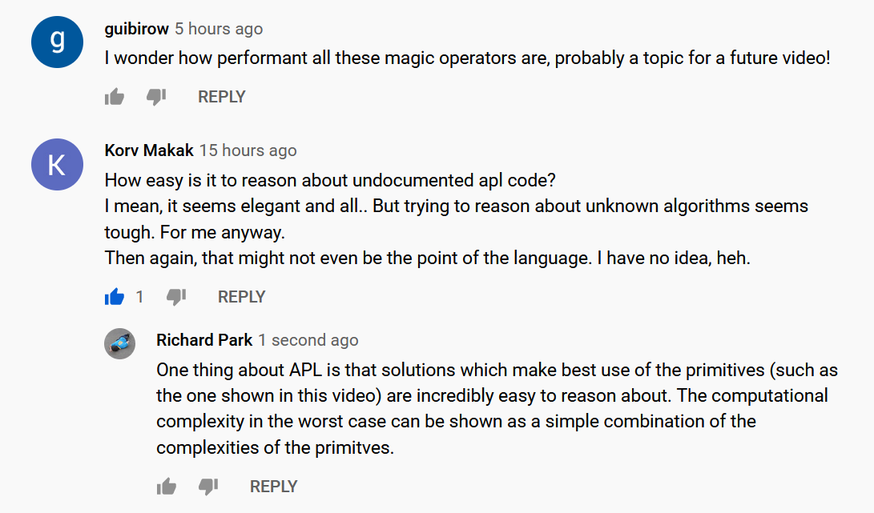

Slide 21
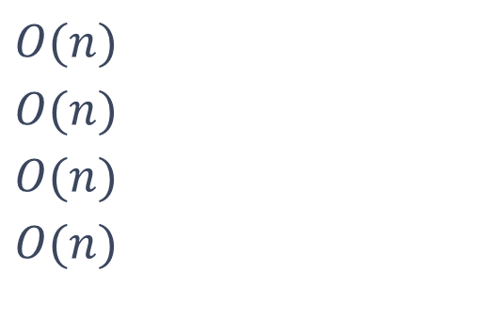
sentence⌿⍨4>+\' '=sentence
=
+\
>
⌿⍨
$$O(n)$$
$$O(n)$$
$$O(n)$$
$O(n)$

Slide 22
sentence⌿⍨4>+\' '=sentence
1↓∊' '∘,¨4↑' '(≠⊆⊢)sentence

Slide 23
Experimentation at Many Levels of Abstraction
“The psychological profiling [of a programmer] is mostly the ability to shift levels of abstraction, from low level to high level. To see something in the small and to see something in the large.”
— Jack Woehr. An interview with Donald Knuth. Dr. Dobb’s Journal, pages 16–22 (April 1996)

Slide 24
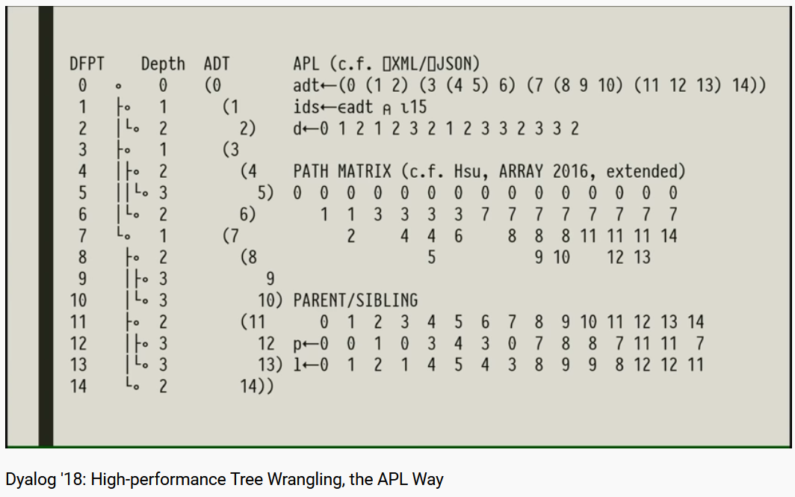
Experimentation at Many Levels of Abstraction

Slide 25
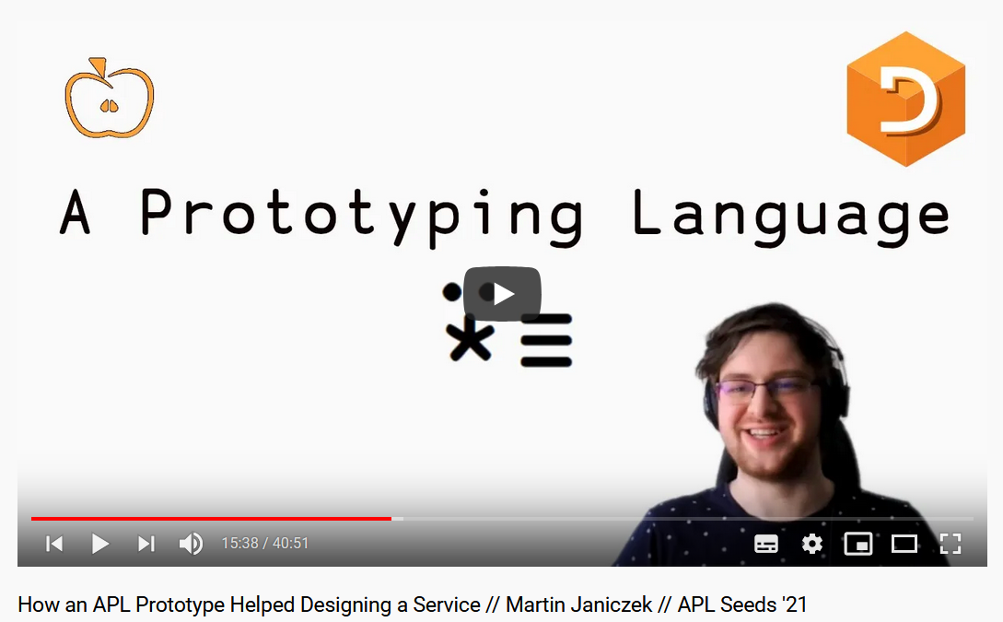
Experimentation at Many Levels of Abstraction
"I am supposed to consume that service from the front end. I maybe understand it from a 10,000 ft view but I know very little about how it works internally."

Slide 26
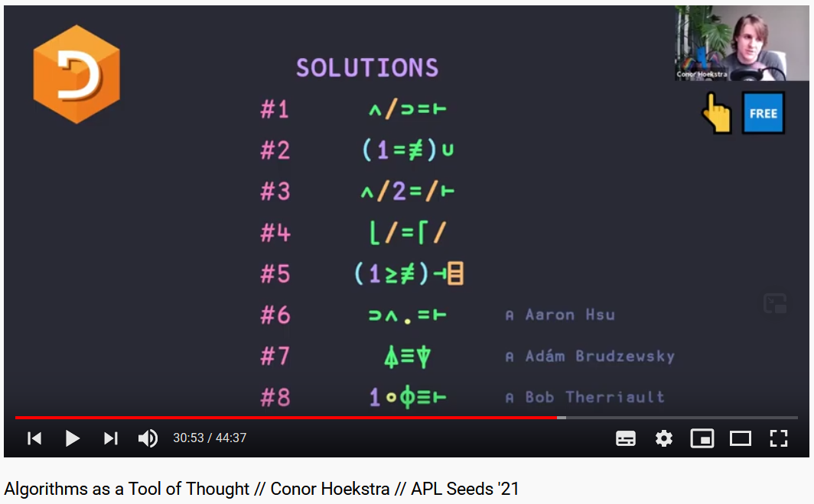
Experimentation at many levels of abstraction

Slide 27
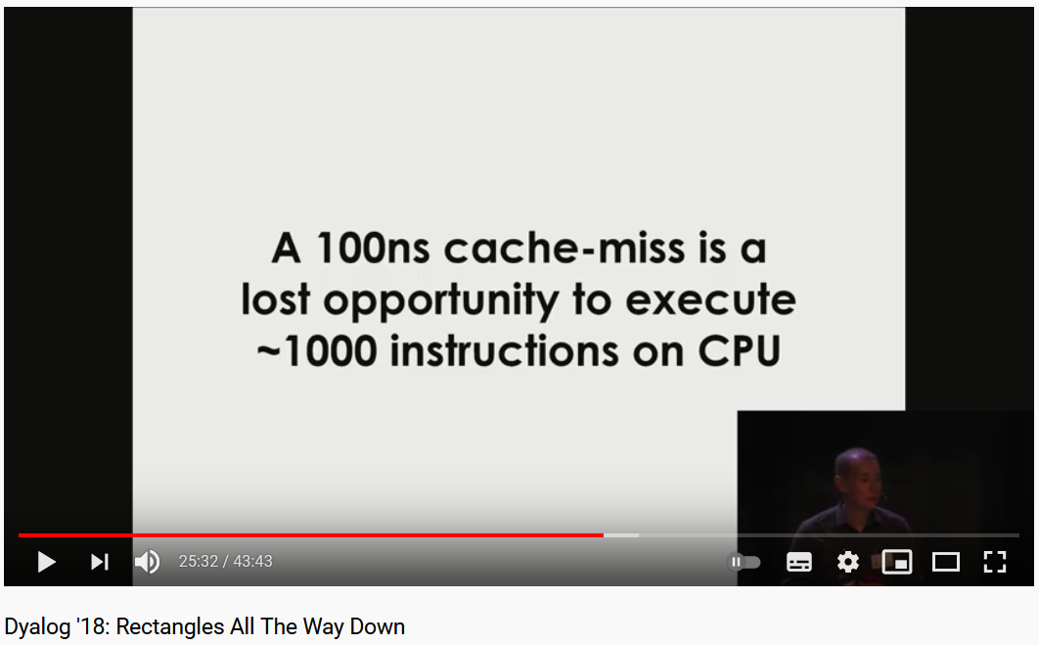
Benefits of Array Programming Techniques

Slide 28
What about normal people stuff?
We've got you covered
Text/CSV/JSON/XML
Databases
Web Services
Containerised Deployment
System Interaction
Foreign Function Interface
Graphics

Slide 29
So who's using this anyway?
Production
Management
Finance
Medicine
Science
Simulation
Computer Science

Slide 30
Why should I start learning today?
Annual APL Problem Solving Competition
Over two months left to enter
Compete for $$$
Referral awards $$$
Previous winners learned APL while participating
dyalogaplcompetition.com

Slide 31
Want more?
tryapl.org
apl.wiki
apl.chat
arraycast.com
dyalog.tv

Slide 32
Further Reading
rikedyp.uk/accu
Thank You

